Slide 1

Android 新技术趋势
高超 - 字节跳动 Android 工程师
Notes:
自我介绍 回顾历史 细分领域 业务开发演进趋势 开课目的

Slide 2

目录
现代 Android 开发语言：Kotlin
现代 Android 应用架构
Android Jetpack 提供最佳架构支持
Android 样板工程 sunflower 的解析
Notes:
开源社区活跃，技术演进快，Google 主导

Slide 3
Android 一等公民——kotlin
Notes:
自我介绍 回顾历史 细分领域 业务开发演进趋势 开课目的

Slide 4

Kotlin
https://kotlinlang.org/

Slide 5
Kotlin
A statically typed, cross-platform, general-purpose programming language with type inference.
Mainly targets the JVM, but also compiles to JavaScript or native code (via LLVM).
Sponsored by JetBrains, a software development company based in Prague, and is also backed by Google under the Kotlin Foundation.

Slide 6
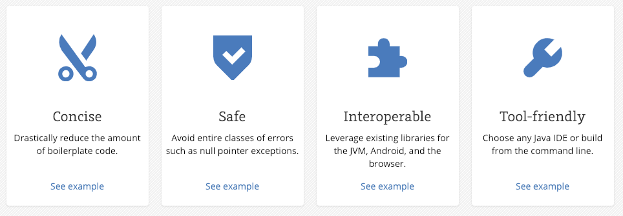
Why Kotlin

Slide 7
Kotlin
为了让 java 开发者快速的融入到 kotlin 的开发中，kotlin 提供了和 java 的几乎 100% 的互操作性。
也就是说，你可以通过 kotlin 调用你之前编写的所有 java 代码，同样的，你也可以在 java 中无缝调用 kotlin 中的代码。
大家思考一下，这是怎么实现的呢？

Slide 8
Kotlin
一些直观的例子，和 java 进行对比

Slide 9
Null Safety
// Java
void int getLastNameLength(User user) {
if (user != null
&& user.info != null
&& user.info.basicInfo != null
&& user.info.basicInfo.name != null
&& user.info.basicInfo.name.lastName != null) {
return user.info.basicInfo.name.lastName.length();
} else {
return -1;
}
}

Slide 10
Null Safety
// Java
void int getLastNameLength(User user) {
if (user != null
&& user.info != null
&& user.info.basicInfo != null
&& user.info.basicInfo.name != null
&& user.info.basicInfo.name.lastName != null) {
return user.info.basicInfo.name.lastName.length();
} else {
return -1;
}
}
// Kotlin
fun getLastNameLength(val user: User?)
= user?.info?.basicInfo?.name?.lastName?.length() ?: -1

Slide 11
Default Arguments
// Java
class View {
public View(Context context) { … }
public View(Context context, @Nullable AttributeSet attrs) {
this(context, attrs, 0);
}
public View(Context context, @Nullable AttributeSet attrs,
int defStyleAttr) {
this(context, attrs, defStyleAttr, 0);
}
public View(Context context, @Nullable AttributeSet attrs,
int defStyleAttr, int defStyleRes) {
this(context);
...
}
}

Slide 12
Default Arguments
// Java
class View {
public View(Context context) { … }
public View(Context context, @Nullable AttributeSet attrs) {
this(context, attrs, 0);
}
public View(Context context, @Nullable AttributeSet attrs,
int defStyleAttr) {
this(context, attrs, defStyleAttr, 0);
}
public View(Context context, @Nullable AttributeSet attrs,
int defStyleAttr, int defStyleRes) {
this(context);
...
}
}
// Kotlin
class View(context: Context, attrs: AttributeSet? = null, defStyleAttr: Int = 0,
defStyleRes: Int = 0)

Slide 13
Lazy Initiation
// Java
private MediaPlayer mPlayer;
public synchronized void play(String url) {
if (mPlayer == null) {
mPlayer = createPlayer();
}
mPlayer.play(url);
}

Slide 14
Lazy Initiation
// Java
private MediaPlayer mPlayer;
public synchronized void play(String url) {
if (mPlayer == null) {
mPlayer = createPlayer();
}
mPlayer.play(url);
}
// Kotlin
private val mPlayer: MediaPlayer by lazy {
createPlayer()
}
fun play(val url: String) {
mPlayer.play(url)
}

Slide 15
Data class
// Java
class User {
public final String firstName;
public final String lastName;
public final int age;
public final String avatarUrl;
public final List<User> friends;
public User(String firstName, String lastName,
int age, List<User> friends) {
this.firstName = firstName;
this.lastName = lastName;
this.age = age;
this.avatarUrl = avatarUrl;
this.friends = friends;
}
}

Slide 16
Data class
// Java
class User {
public final String firstName;
public final String lastName;
public final int age;
public final String avatarUrl;
public final List<User> friends;
public User(String firstName, String lastName,
int age, List<User> friends) {
this.firstName = firstName;
this.lastName = lastName;
this.age = age;
this.avatarUrl = avatarUrl;
this.friends = friends;
}
}
// Kotlin
data class User(val firstName: String, val lastName: String,
val age: Int, val avatarUrl: String, val List<User> friends)

Slide 17
Data class
// Java
User mUser;
…
void onAvatarUpdated(String newAvatarUrl) {
List<User> friends = new ArrayList<>();
for (User user : mUser.friends) {
friends.add(user);
}
mUser = new User(mUser.firstName, mUser.lastName,
mUser.age, newAvatarUrl, friends)
}

Slide 18
Data class
// Java
User mUser;
…
void onAvatarUpdated(String newAvatarUrl) {
List<User> friends = new ArrayList<>();
for (User user : mUser.friends) {
friends.add(user);
}
mUser = new User(mUser.firstName, mUser.lastName,
mUser.age, newAvatarUrl, friends)
}
// Kotlin
var mUser
newAvartarUrl -> {
mUser = mUser.copy(avatarUrl = newAvatarUrl)
}

Slide 19
Extension Functions
// Java
public class SwapableArrayList<T> extends ArrayList<T> {
public void swap(int index1, int index2) {
T temp = get(index1);
set(index1, get(index2));
set(index2, temp);
}
}

Slide 20
Extension Functions
// Java
public class SwapableArrayList<T> extends ArrayList<T> {
public void swap(int index1, int index2) {
T temp = get(index1);
set(index1, get(index2));
set(index2, temp);
}
}
// Kotlin
fun MutableList<Int>.swap(index1: Int, index2: Int) {
val tmp = this[index1]
this[index1] = this[index2]
this[index2] = tmp
}

Slide 21
Extension Properties
// Java
public class LastIndexArrayList<T> extends ArrayList<T> {
public void getLastIndex() {
return getSize() - 1;
}
}

Slide 22
Extension Properties
// Java
public class LastIndexArrayList<T> extends ArrayList<T> {
public void getLastIndex() {
return getSize() - 1;
}
}
// Kotlin
val <T> List<T>.lastIndex: Int
get() = size - 1

Slide 23
Extension Properties
// Java
public class LastIndexArrayList<T> extends SwapableArrayList<T> {
public void getLastIndex() {
return getSize() - 1;
}
}
// Kotlin
val <T> List<T>.lastIndex: Int
get() = size - 1

Slide 24
When Expression
// Kotlin
when (x) {
1 -> print("x == 1")
2 -> print("x == 2")
else -> { // Note the block
print("x is neither 1 nor 2")
}
}

Slide 25
When Expression
// Kotlin
when (x) {
1 -> print("x == 1")
2 -> print("x == 2")
else -> { // Note the block
print("x is neither 1 nor 2")
}
}
// Java
switch(x) {
case 1:
print("x == 1");
break;
case 2:
print("x == 2");
break;
default:
print("x is neither 1 nor 2");
break;
}

Slide 26
When Expression
// Kotlin
when (x) {
in 1..10 -> print("x is in the range")
in validNumbers -> print("x is valid")
!in 10..20 -> print("x is outside the range")
else -> print("none of the above")
}

Slide 27

When Expression
// Kotlin
when (x) {
in 1..10 -> print("x is in the range")
in validNumbers -> print("x is valid")
!in 10..20 -> print("x is outside the range")
else -> print("none of the above")
}
// Java

Slide 28
Functional Programming
Kotlin functions are first-class, which means that they can be stored in variables and data structures, passed as arguments to and returned from other higher-order functions.
Kotlin 中的函数（functions）是一等公民，这意味着函数可以被赋值给变量或者其他数据结构，然后作为参数传递给其他的函数。
接受函数的函数，称为「高阶函数」。

Slide 29
Functional Programming
// OOP
class Calculator {
double plus(int a, int b) { return a + b; }
double minus(int a, int b) { return a - b; }
double multiply(int a, int b) { return a * b; }
double divide(int a, int b) { return a / b; }
...
}

Slide 30
Functional Programming
// OOP
class Calculator {
double plus(int a, int b) { return a + b; }
double minus(int a, int b) { return a - b; }
double multiply(int a, int b) { return a * b; }
double divide(int a, int b) { return a / b; }
...
}
// FP
typealias Operator = (Double, Double) -> Double
val plus: Operator = { a, b -> a + b}
val minus: Operator = { a, b -> a - b}
val multiply: Operator = { a, b -> a * b}
val divide: Operator = { a, b -> a / b}
fun operate(val a: Double, val b: Double, operator: Operator)
= operator(a, b)
val sum = operate(4, 6, cal.plus)

Slide 31
Functional Programming
fun <T, R> Collection<T>.fold(
initial: R,
combine: (acc: R, nextElement: T) -> R
): R {
var accumulator: R = initial
for (element: T in this) {
accumulator = combine(accumulator, element)
}
return accumulator
}
val items = listOf(1, 2, 3, 4, 5)
// sum
items.fold(0, {
acc: Int, i: Int ->
val result = acc + i
})
// multiply
val product = items.fold(1, Int::times)
// joined to string
val joinedToString = items.fold("Elements:", { acc, i -> acc + " " + i })

Slide 32
KTX
// Kotlin
sharedPreferences.edit()
.putBoolean("key", value)
.apply()
db.beginTransaction()
try {
// insert data
db.setTransactionSuccessful()
} finally {
db.endTransaction()
}
// Kotlin + KTX
sharedPreferences.edit {
putBoolean("key", value)
}
db.transaction {
// insert data
}

Slide 33
Android 的大事——应用架构
Notes:
自我介绍 回顾历史 细分领域 业务开发演进趋势 开课目的

Slide 34
现代 Android 应用架构
什么是好的客户端架构？

Slide 35
现代 Android 应用架构
一个好的架构应该满足：
能够「保质」满足快速迭代的业务需求
代码分工清晰明确，易于阅读维护
易于测试，方便进行各种自动化测试
Notes:
开源社区活跃，技术演进快，Google 主导

Slide 36
现代 Android 应用架构
历史上，针对提供客户交互的软件，出现过 3 种流行的架构：
MVC（Model-View-Controller）
MVP（Model-View-Presenter）
MVVM（Model-View-ViewModel）
Notes:
开源社区活跃，技术演进快，Google 主导

Slide 37
现代 Android 应用架构
优点：
业务逻辑存储在 Model 中
支持异步编程技术
界面重构，不会过多影响到 Model
缺点：
controller 膨胀，难以维护
相互都存在耦合，UT 难以支持
随着业务发展，复杂度暴增
Notes:
开源社区活跃，技术演进快，Google 主导

Slide 38
现代 Android 应用架构
优点：
View 足够轻量，可以满足快速迭代
View 和 Presenter 可以复用
代码易读、易维护
业务逻辑和 UI 分离，容易构建 UT
缺点：
View 和 Presenter 耦合较深
为了提供较高程度的抽象，各个层次之间的抽象接口很多
相同业务逻辑，代码规模很大
Notes:
开源社区活跃，技术演进快，Google 主导

Slide 39
现代 Android 应用架构
优点：
View 和 ViewModel 之间耦合很低
View 和 ViewModel 之间没有抽象接口
事件驱动，UT 易于构建
缺点：
需要为每一个 UI 组件构建观察者
相同业务逻辑，代码规模很大
Notes:
开源社区活跃，技术演进快，Google 主导

Slide 40
现代 Android 应用架构
更进一步了解三种架构风格：
http://www.linuxidc.com/Linux/2015-10/124622.htm
Notes:
开源社区活跃，技术演进快，Google 主导

Slide 41
现代 Android 应用架构
为了降低开发实现 MVVM 架构，Android 提供了 jetpack libraries 来简化实现门槛。
Notes:
不全是新的东西，多年演化和积累的结果

Slide 42

Jetpack
Jetpack 是由 android 推出的，旨在帮助开发者
按照最佳实践的方式
以最低的代价
最快的速度交付
最佳质量
的应用程序的一套库集合。
Notes:
不全是新的东西，多年演化和积累的结果

Slide 43
Jetpack
利用 jetpack，你可以
遵循 android 平台的最佳开发实践
最少或者避免模版代码，聚焦于业务逻辑
构建高质量、鲁棒性的应用程序
Notes:
核心是提升效率

Slide 44
Jetpack
Notes:
核心是提升效率

Slide 45
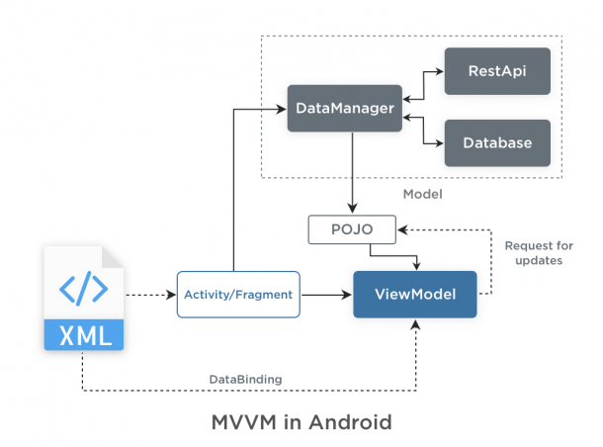
Architecture

Slide 46
LiveData

Slide 47
LiveData
Without LiveData
// ViewModel
List<User> userList;
List<UserLoadedListener> listeners = new ArrayList<>()
void registerListener(UserLoadedListener lsn) {
listeners.add(lsn)
}
void unregisterListener(UserLoadedListener lsn) {
listeners.remove(lsn)
}
void loadUsers() {
userService.getUsers(data -> {
userList = data;
// notify UI
for(UserLoadedListener lsn : listeners) {
lsn.onUserLoaded(userList);
}
})
}
// Activity
UserLoadedListener listener = data -> {
// update UI
}
// onCreate
userViewModel.registerListener(userListener);
userViewModel.loadUsers();
…
//onDestroy
userViewModel.unregisterListener(listener);

Slide 48
LiveData
With LiveData
// ViewModel
private MutableLiveData<List<User>> users;
public LiveData<List<User>> getUsers() {
if (users == null) {
users = new MutableLiveData<List<User>>();
userRepository.loadUsers(data -> {
userList.setValue(data);
})
}
return users;
}
// Activity
getUsers().observe(this, users -> {
// update UI
});

Slide 49
LiveData
Transformations
// map
LiveData<User> userLiveData = ...;
LiveData<String> userName = Transformations.map(userLiveData, user -> {
user.name + " " + user.lastName
});
// switchMap
private LiveData<User> getUser(String id) {
...;
}
LiveData<String> userId = ...;
LiveData<User> user = Transformations.switchMap(userId, id -> getUser(id) );

Slide 50
ViewModel

Slide 51
ViewModel
public class UserViewModel extends ViewModel {
private MutableLiveData<List<User>> users;
public LiveData<List<User>> getUsers() {
if (users == null) {
users = new MutableLiveData<List<User>>();
userRepository.loadUsers(data -> {
users.setValue(data);
})
}
return users;
}
}

Slide 52
ViewModel
public class UserActivity extends AppCompatActivity {
@Override
public void onCreate(Bundle savedInstanceState) {
UserViewModel model = ViewModelProviders.of(this).get(UserViewModel.class);
model.getUsers().observe(this, users -> {
// update UI
});
}
}

Slide 53
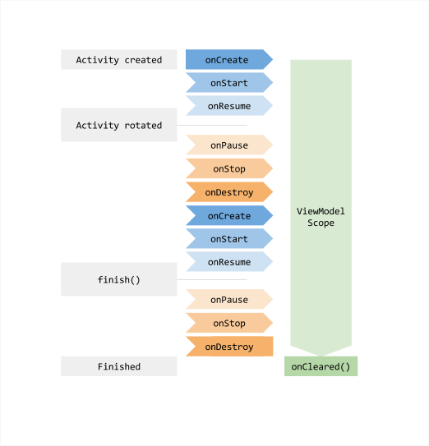
ViewModel

Slide 54
Lifecycles

Slide 55
Lifecycles
public class UserActivity extends AppCompatActivity {
@Override
public void onCreate(Bundle savedInstanceState) {
UserViewModel model = ViewModelProviders.of(this).get(UserViewModel.class);
model.getUsers().observe(this, users -> {
// update UI
});
}
}

Slide 56
Lifecycles
Fragments and Activities in Support Library 26.1.0 and later already implement the LifecycleOwner interface.
class AppCompatActivity extends Activity implements LifecycleOwner
class Fragment implements LifecycleOwner

Slide 57
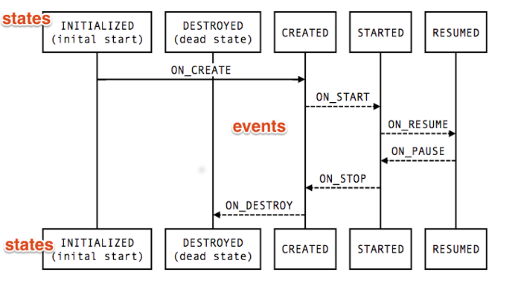
Lifecycles

Slide 58
Lifecycles
Activated

Slide 59
DataBinding

Slide 60
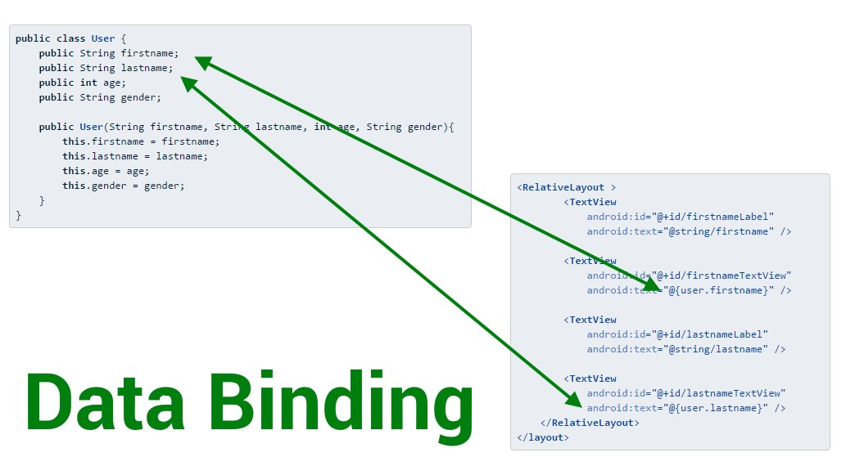
DataBinding

Slide 61
DataBinding
ViewModel
class UserModel extends ViewModel {
public final MutableLiveData<String> nickName = new MutableLiveData<>();
public final MutableLiveData<Integer> age = new MutableLiveData<>();
...
}

Slide 62
DataBinding
XML
<layout xmlns:android="http://schemas.android.com/apk/res/android">
<data>
<variable name="user" type="com.example.UserModel"/>
</data>
...
<TextView android:layout_width="wrap_content"
android:layout_height="wrap_content"
android:text="@{user.nickName}" />
...
</layout>

Slide 63
DataBinding
Activity
class UserActivity : AppCompatActivity() {
override fun onCreate(savedInstanceState: Bundle?) {
UserModel userModel = ViewModelProviders.of(getActivity()).get(UserModel.class)
val binding: UserBinding = DataBindingUtil.setContentView(this, R.layout.user)
binding.setLifecycleOwner(this)
binding.viewmodel = userModel
}
}

Slide 64
LiveData
LiveData
ViewModel
Lifecycles
Data Binding

Slide 65
Android 的样板间——sunflower 解析
Notes:
自我介绍 回顾历史 细分领域 业务开发演进趋势 开课目的

Slide 66
SunFlower
Android 提供了怎么多 jetpack 库，我们该怎么将他们融合到一个项目中呢？有没有一个比较全面的 example 工程可以参考呢？
有的，它就是 sunflower：https://github.com/android/sunflower
Notes:
核心是提升效率

Slide 67

THANKS.

